Slide 1
GInAS/GSRS Meeting
CDER Informatics Initiatives and the IDMP
Mary Ann Slack
Director
Office of Strategic Programs (OSP)
Center for Drug Evaluation and Research (CDER)
November 16, 2018

Slide 2
FDA Disclaimer
The views and opinions presented here represent those of the speaker and should not be considered to represent advice or guidance on behalf of the U.S. Food and Drug Administration.

Slide 3
Selected CDER Standardization Topic Areas
Product Quality/Chemistry & Manufacturing Controls (PQ/CMC)
Real-world evidence (RWE)
IDMP implementation
E2B IND Safety Reports

Slide 4
PQ/CMC Initiative

Slide 5
PQ/CMC
The PQ/CMC project is aimed at developing and implementing structured data standards for quality/CMC submissions to marketing applications
Benefits: Consistent high-quality computable data requiring no human interpretation; hi-tech quality assessments; and Improved crisis response
Involves CDER, CBER and CVM
Includes IDMP harmonization (where feasible)
Topic informally broached in ICH with interest expressed
This first phase includes over 150 data elements within eCTD Module 3 (CMC), analyzed and defined, with new controlled terms proposed where appropriate

Slide 6
PQ/CMC Public Meeting
Public Meeting on PQ/CMC standardized data conducted on Oct 19
Objectives: to share progress on the standardization effort, provide perspective on FRN comments (over 480), and solicit stakeholder inputs
Next steps
Development & testing of appropriate combination of technologies (e.g. FHIR)
Proof of concept using Quality Specification to inform next steps for the full scope
Development of draft guidance

Slide 7
Real-world evidence (RWE)

Slide 8
FDA CDER Definitions
Real World Data are data relating to patient health status and/or the delivery of health care routinely collected from a variety of sources.
Real World Evidence is the clinical evidence regarding the usage and potential benefits or risks of a medical product derived from analysis of RWD.
RWD include data derived from electronic health records (EHRs), claims and billing data, data from product and disease registries, patient-generated data including in home-use settings, and data gathered from other sources that can inform on health status, such as mobile devices.
RWE can be generated using many different study designs, including but not limited to, randomized trials, such as large simple trials, pragmatic clinical trials, and observational studies (prospective and/or retrospective).

Slide 9
Wide Spectrum of Potential Uses of RWD/RWE in Clinical Studies
Interventional non-randomized
Non-randomized / non-interventional
Randomized interventional
Traditional Randomized Trial Using RWD Elements
Observational Studies
Trials in Clinical Practice Settings
RWE to assess enrollment criteria / trial feasibility
eCRF + selected outcomes identified using EHR/claims data
Pragmatic RCTs
Prospective data collection
Pragmatic RCT using eCRF (+/- eHR data)
Single arm study using external control
Registry trials/study
Pragmatic RCT using claims and eHR data
Prospective Cohort
Study
Mobile technology
used to capture supportive endpoints (e.g., to assess ambulation)
Using existing databases
RWE to support site selection
Case – Control
Retrospective Cohort Study (HC)
Increasing reliance on RWD
Traditional RCTs
RWE / pragmatic RCTs
Observational cohort studies

Slide 10

21st Century Cures: Expectations
Section 3022 of the Cures Act states:
FDA shall establish a program to evaluate the potential use of real world evidence (RWE) to support:
Approval of new indication for a drug approved under section 505(c)
Satisfy post-approval study requirements
Program will be based on a framework that:
Categorizes sources of RWE and gaps in data collection
Identifies standards and methodologies for collection and analysis
Describes the priority areas, remaining challenges and potential pilot opportunities that the program will address
Framework for program implementation will be developed in consultation with stakeholders.
Real world evidence means data regarding the usage, or the potential benefits or risks, of a drug derived from sources other than traditional clinical trials

Slide 11
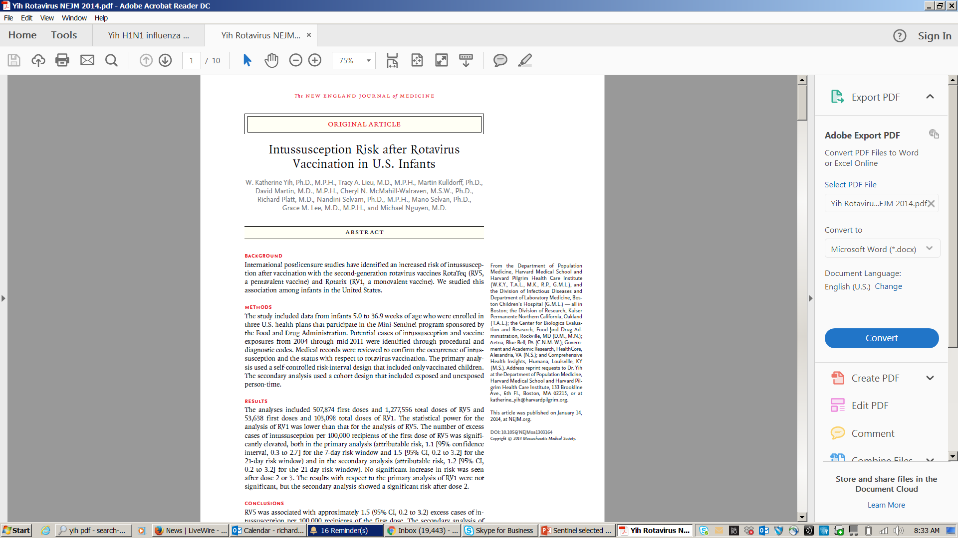
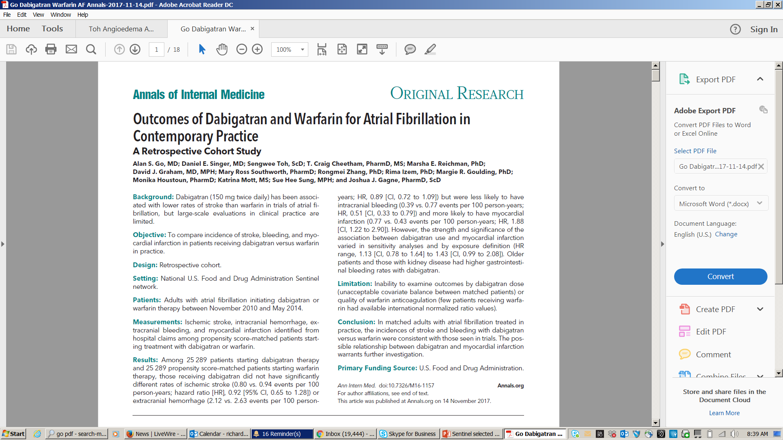
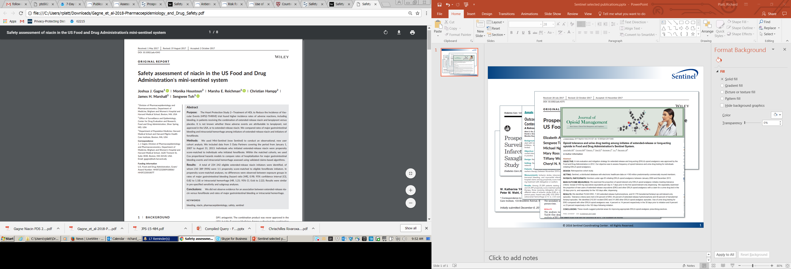
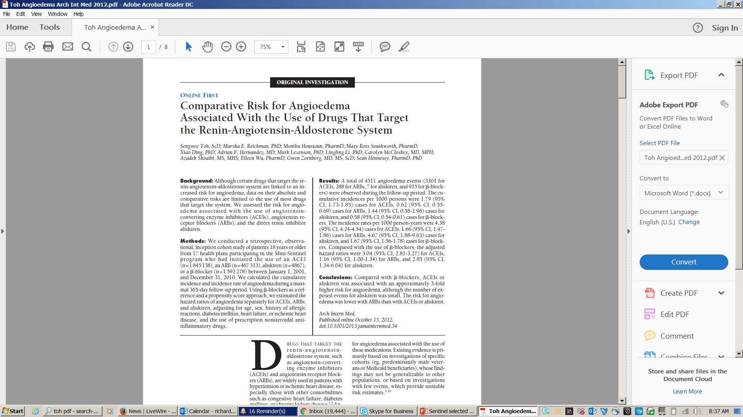
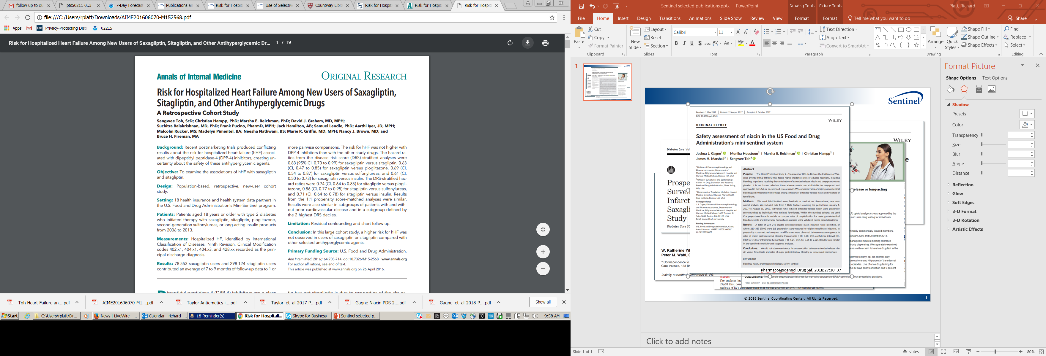
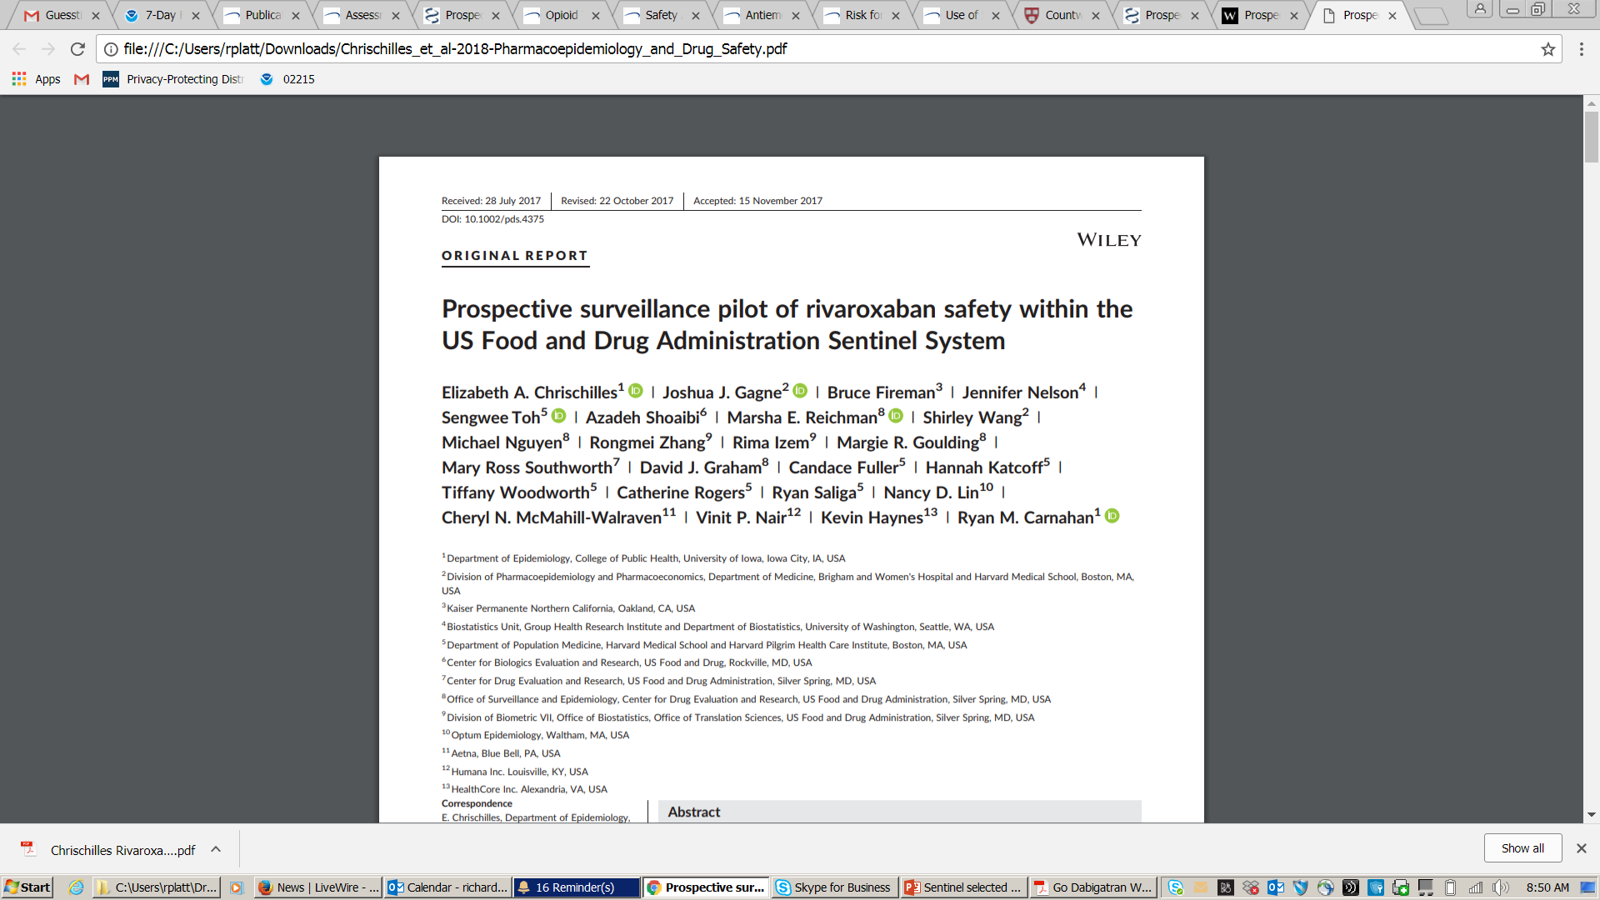
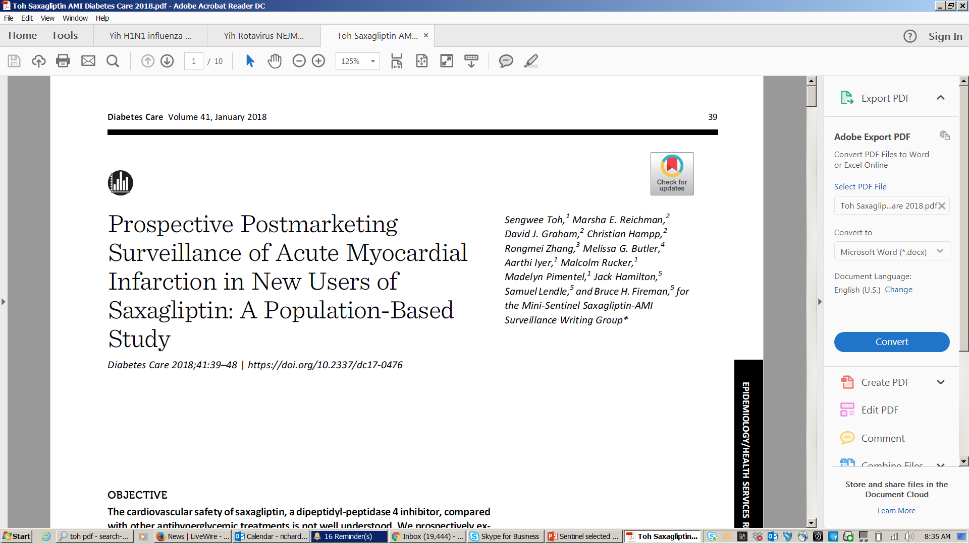
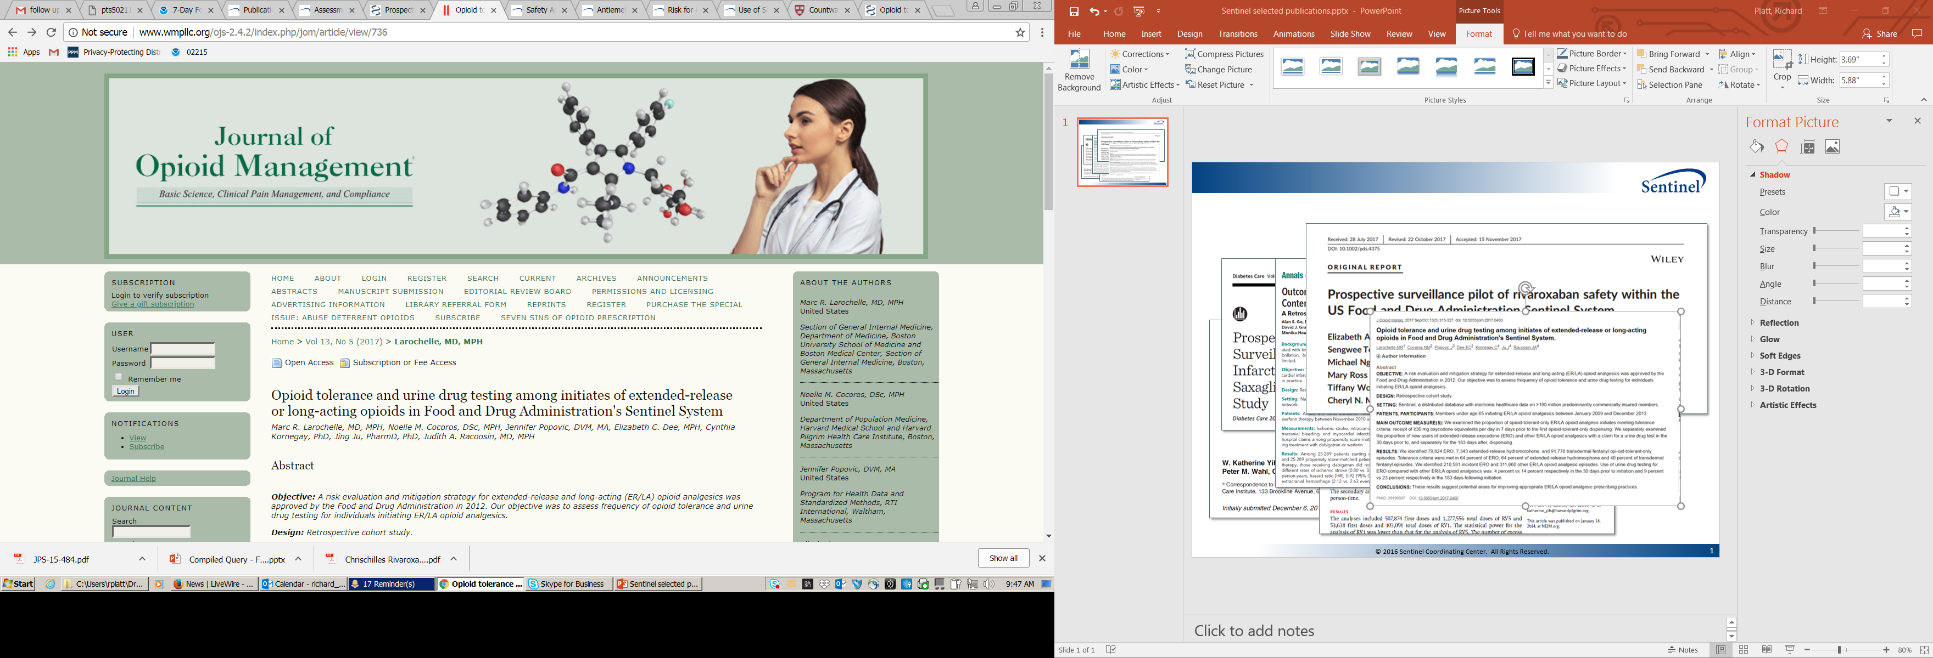
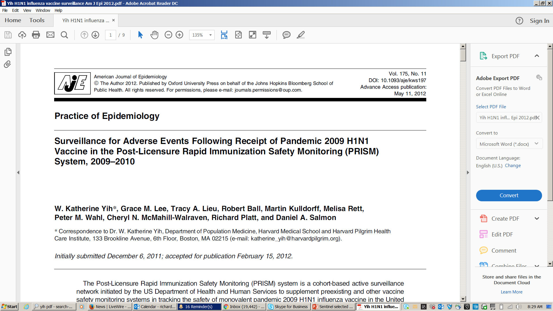
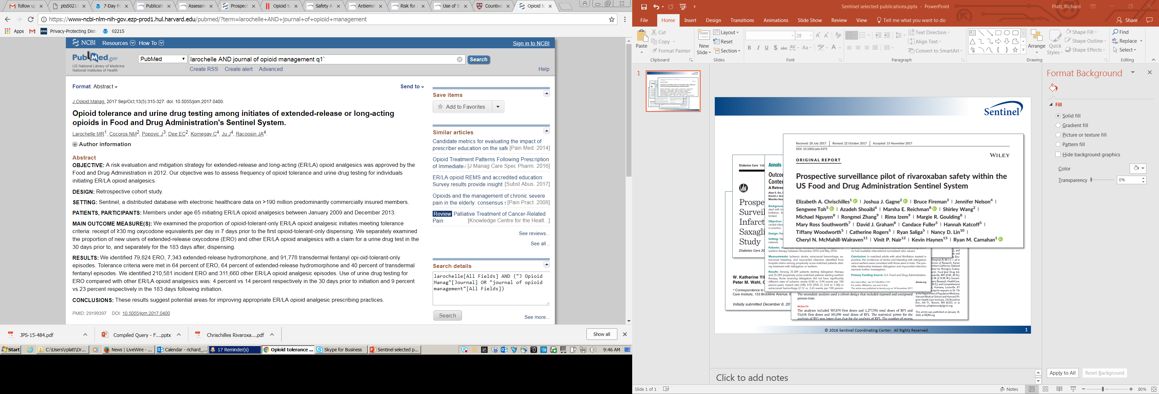
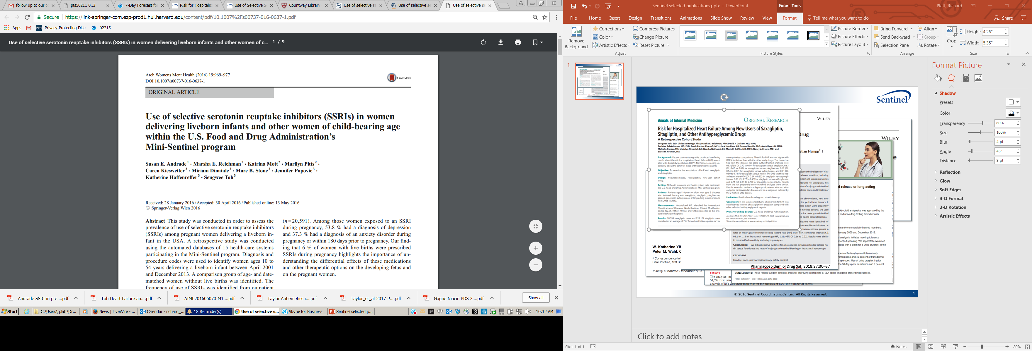
FDA has Embraced RWE for Safety
Pharmacoepidemiol Drug Saf. 2018;27:30–37

Slide 12

Demonstration Projects: Assessing Data Fitness
Collaboration between Duke Clinical Research Institute and GlaxoSmithKline
Supported by FDA
Assessing EHR ability to:
Facilitate recruitment
Populate baseline characteristics
Identify clinical endpoints
July 14, 2017: Leveraging Electronic Health Data in a Multinational Clinical Trial: Early Learnings from the HARMONY-Outcomes EHR Ancillary Study
http://www.rethinkingclinicaltrials.org/grand-rounds-7-14-17/
Effect of Albiglutide, When Added to Standard Blood Glucose Lowering Therapies, on Major Cardiovascular Events in Subjects With Type 2 Diabetes Mellitus – NCT02465515

Slide 13
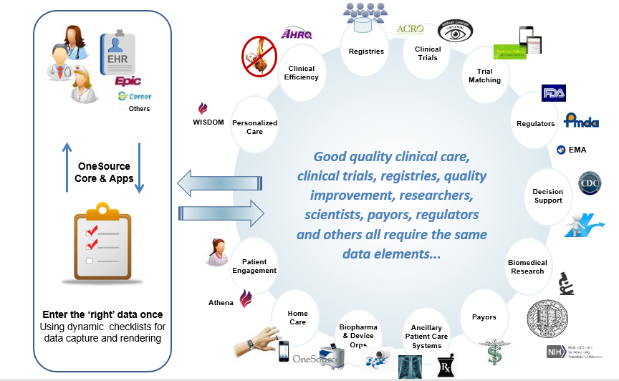
Demonstration Projects: Assessing Data Fitness / Standards
OneSource: “enter the right clinical data once, use many times”
FDA collaboration with Dr. Laura Esserman, UCSF
Integration of standards based tools into the EHR to bring together health care and research
Demonstration in breast cancer clinical trials
Courtesy of Dr. Laura Esserman and Susan Dubman

Slide 14
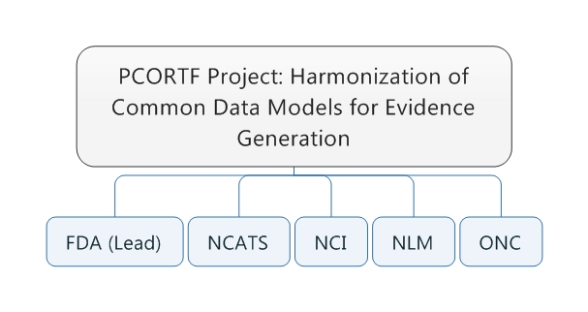
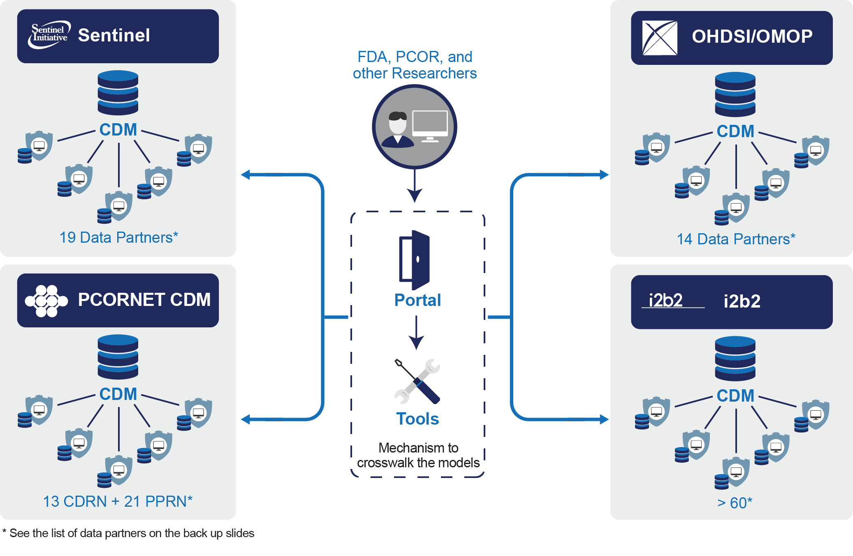
Demonstration Projects: Harmonization of Common Data Models
FUTURE State
Networks of observational data use different Common data Models
Open, consensus-based standards might not be leveraged in these CDMs (ex: CDISC, HL7)
There is a need to facilitate interoperability among these collaborations

Slide 15
Observational Studies and Effectiveness
Using RWD analyses for Effectiveness Research
Brigham and Women’s Hospital (Dr. Schneeweiss) and Harvard Medical School collaboration
Using a scalable analytics platform with Medicare and commercial claims databases, investigators will try to use RWD to replicate the findings of phase 3 or 4 randomized controlled trials relevant to regulatory science.

Slide 16
FDA’s approach to IDMP

Slide 17



FDA’s Approach to ISO IDMP Standards
Medicinal Product Identification
01
01
U.S. National Drug Code (NDC)
ISO 11615
ISO 11615
ISO
11238
Substance Identification
02
02
Unique Ingredient Identifier (UNII)
ISO
11238
ISO
11240
Units of
Measure
03
03
Unified Code
for Units of Measure (UCUM)
ISO
11240
03
ISO
11239
Dosage Form & Routes of Administration
FDA SPL Terminology
mapped to EDQM
ISO
11239
04
04
ISO
11616
Pharmaceutical Product ID
05
05
Pharmaceutical Product ID
ISO
11616

Slide 18
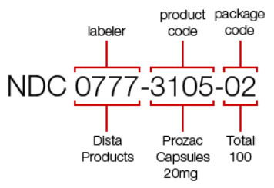
ISO
11615
Medicinal Product Identification (MPID)
MPID Description
Data elements and structures for unique identification and exchange of regulated medicinal product information
U.S. National Drug Code (NDC) is FDA’s regional MPID
First two segments of the NDC code will be used to represent MPID
The full NDC will be used to represent the medicinal product at the package level (known as the PCID)
Example:
Regional
Identifiers

Slide 19
ISO
11615
Medicinal Product Identification (MPID)
MPID Exchange Standard (ISO/TS20443)
FDA uses SPL (HL7 v3 message) for labeling and drug listing and registration submissions, and does not currently have plans to change
FDA determined that the MPID required components are captured in the SPL label
Indication will be captured prospectively via regulatory submissions
FDA is collaborating with EMA to develop and test HL7 Fast Healthcare Interoperability Resource (FHIR) for information exchange
Test will ensure adherence to the ISO (TS20443) technical specification, *and*
FDA will evaluate and determine steps necessary to accept FHIR messages as well as SPL

Slide 20
ISO
11238
Substance Identification (SubID)
SubID Description
Data elements and structures for unique identification and exchange of regulated information on substances
Unique Ingredient Identifier (UNII), ISO 11238 compatible, used by FDA for many years to uniquely and unambiguously identify substances
The Open Source Global Substance Registration System (GSRS) has been developed and is available at https://tripod.nih.gov/ginas/#/
FDA-GSRS is in production (approx. 150,000 entries)

Slide 21
ISO
11238
Substance Identification (SubID)
Collaboration to make GSRS a much richer system
EMA co-developing GSRS in their environment
Ensure that the systems remain synchronized as a global effort
Substance ID Exchange Standard
Testing of a FHIR Substance Registration resource is planned for HL7 Connectathon in May 2019
Exploring the capability for Sponsors to register their own substances

Slide 22
ISO
11239
Dosage Form (DF) &
Route of Administration (RoA)
DF & RoA Description
Data elements and structures for unique identification and exchange of regulated information on pharmaceutical dose forms, units of presentation, routes of administration and packaging
European Directorate for the Quality of Medicines (EDQM) terminology identified as the ISO 11239 compliant terminology set and maintenance organization
FDA Terminology for SPL (SPL) is used in electronic content of labeling, and drug registration and listing; also used in CDISC Controlled Terminology
National Cancer Institute / Enterprise Vocabulary Service (NCI /EVS) curates the SPL terminology as part of the larger NCI terminology

Slide 23
ISO
11239
Dosage Form (DF) &
Route of Administration (RoA)
EDQM terminology is hierarchical and more granular
For example, 166 SPL DF terms vs ~536 EDQM BDF & PDF terms
NCI / EVS added the entire EDQM terminology to the NCI terminology
NCI / EVS and FDA mapped SPL to EDQM Terminology for DF and RoA
Currently, FDA and NCI/EVS are reviewing the mapping and gaps to determine next steps
Update: FDA is reviewing the standard for a potential higher level interpretation that would enable FDA terminology for SPL to become compliant; else no plans to transition for content of labeling at this time.
Note: Drug product nomenclature (i.e. container labels, carton labeling and prescribing information) will continue to use USP terminology as per FD&C Act.

Slide 24
ISO
11240
Units of Measurement
Units of Measurement Definition
Data elements and structures for unique identification and exchange of units of measurement
The Unified Code for Units of Measure (UCUM) was selected as the ISO 11240 compliant standard
UCUM is a system intended to include all units of measures being contemporarily used in international science, engineering, and business
Currently, FDA receives submissions that use the UCUM syntax standard for dosage strength in both content of product labeling and drug establishment registration and drug listing.

Slide 25
ISO
11616
Pharmaceutical Product Identification (PhPID)
PhPID Description - PhPID is a code generated by an algorithm that can be used to determine pharmaceutical equivalence of products
FDA is currently testing the generation of regional PhPIDs
In May 2018, WHO/ UMC presented a conceptual proposal for validation and maintenance of global PhPIDs.
Planning to participate at a technical and policy working group meeting in 4Q 2018.
PhPID_SUB_L1 → Substance Term(s)
PhPID_SUB_L2 → Substance Term(s) + Strength + reference strength
PhPID_SUB_L3 → Substance Term(s) + Administrable Dose Form
PhPID_SUB_L4 → Substance Term(s) + Strength + reference strength + Administrable Dose Form

Slide 26
IDMP on FHIR
In January, the EU endorsed using FHIR as the basis for the API for the Product Management Service
Makes FHIR the data standard that supports the exchange of information about medicinal products, substances, and related reference data in the EU
HL7’s BR&R workgroup presently sponsors the development of ISO IDMP 11238 (Substance Specification) and IDMP 11615 (Medicinal Product) resources
Medicinal Product resource development takes place in collaboration with HL7’s Pharmacy work group
The goal is to harmonize IDMP and the existing product resources reflecting Pharmacy use cases
Initial work (ready for ballot) is expected to be completed for January 2019 HL7 WG meeting
IDMP resources are expected to be balloted for May 2019 meeting

Slide 27
E2B IND Safety Report

Slide 28
E2B IND Safety Report
Primary Objective
Implement a digital framework for the electronic submission, review, and tracking of IND safety reports to improve FDA’s ability to detect, track, and act upon safety signals that occur during the conduct of clinical trials.
IND sponsors are required to report serious adverse reactions
Current process for submission and review of IND safety reports submitted as PDF files or on paper is inefficient, labor intensive, and poses significant challenges for safety signal detection and tracking
CDER is conducting a pilot, with six participating sponsors, to created a digital framework for the electronic submission of IND safety reports using ICH E2B data standards
CDER expects to implement the new digital framework and issues guidance in late FY2019
Need to identify and assign unique substance ID (UNII) during IND phase

Slide 29
Thank you

